Slide 1
Vermont’s American Rescue Plan Act
Developing community-scale drinking water and wastewater systems in unserved Villages
November 16, 2021
Lynnette Claudon, PE
Water Investment Division

Slide 2
Introductions
Lynnette Claudon-Village WW
1-802-490-6226
Lynnette.Claudon@Vermont.gov
Megan Young-Village DW
1-802-585-4903
Megan.Young@Vermont.gov
Neil Kamman – Water Investment Div.
1-802-490-6137
Neil.Kamman@Vermont.gov
Padraic Monks - CWSRF & DWSRF
1-802-490-6169
Padraic.Monks@Vermont.gov
Tom Brown- CWSRF & DWSRF
1-802-622-4205
Thomas.Brown@Vermont.gov

Slide 3
Initiative Introduction
Village Water and Wastewater Initiative
https://dec.vermont.gov/village-wastewater
Interagency Village Initiative Committee
Meeting our statewide planning goals
Recovery, resilient, strong local economies
Improvements to public health and water quality

Slide 4
ARPA Funding Available
SFY22 ~ $8 Million, allocated based on Priority List
SFY23 & FY24 – anticipate total $15 Million
GOAL: Provide financial support for communities implementing Village drinking water and wastewater to bring user rates into an affordable range.

Slide 5
Initial Eligibility Screening
CW-2
a+b
1
OR
DW-3 a+b+c

Slide 6
1. Village Designation
Villages receiving Village WWW ARPA construction grants need to have received a Village Designation by ACCD
https://accd.vermont.gov/community-development/designation-programs/village-centers

Slide 7
2. New Community Wastewater Systems
A. Projects must CWSRF eligible.
B. Villages seeking wastewater funding must be presently unsewered (meaning that they have individual septic systems) and have a CWSRF eligible project.
  Note: Towns with existing town-owned direct discharge systems or indirect discharge systems are generally not eligible.
  https://www.epa.gov/sites/default/files/2016-07/documents/overview_of_cwsrf_eligibilities_may_2016.pdf

Slide 8
3. New Drinking Water Systems
Villages seeking drinking water funding must have the following:
  A DWSRF Eligible Project
  A documented public health risk
  Unserved: No municipally owned, public community drinking water system
https://www.epa.gov/dwsrf/dwsrf-eligibility-handbook

Slide 9
How to Apply
Complete the Intake Form
https://anr.vermont.gov/content/village-water-wastewater-initiative
Complete the Project Priority List Application https://dec.vermont.gov/water-investment/water-financing/srf/priority-list
Include the WID Project Cost Summary https://anrweb.vt.gov/DEC/IronPIG/DownloadFile.aspx?DID=175611&DVID=0
Additional Forms will be required from applicants in the fundable range.

Slide 10
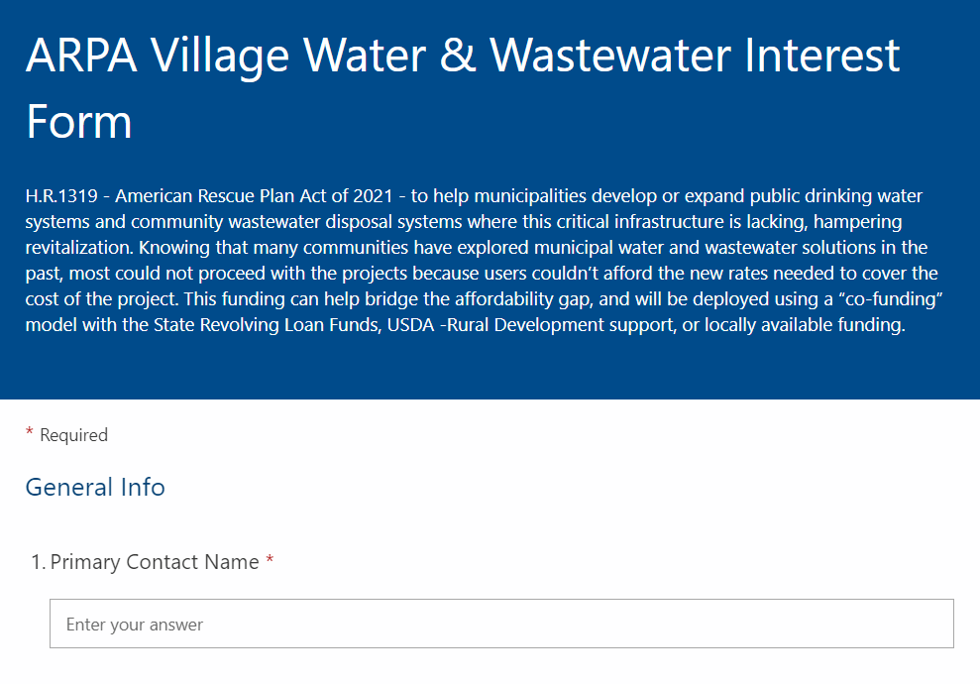
1.
Intake
Form

Slide 11
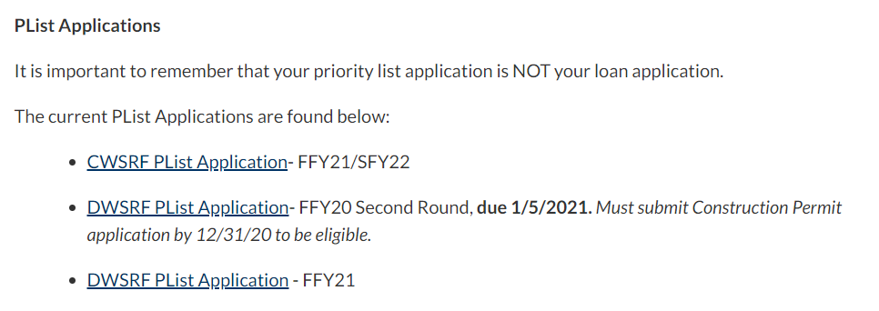
2. Project Priority List Form https://dec.vermont.gov/water-investment/water-financing/srf/priority-list

Slide 12
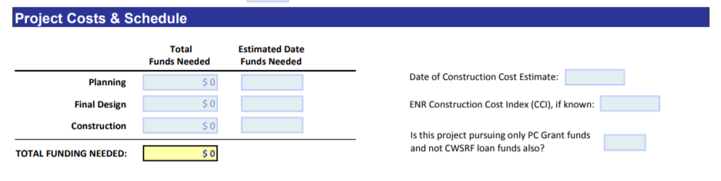
Project Priority List Application
Wastewater: First two pages are most important.

Slide 13
Project Description
Indicate that your project is interested in the ARPA funding.
Include details about the project.
Wastewater: Have the soil test pits been done?
Both: Is there a Purchase and Sales agreement with the landowner or does the municipality already own the land?
Wastewater: Does the land have a formal capacity determination?
Drinking Water: Does the source have approval?
Drinking Water: Include any requests for planning or design funds in the description.

Slide 14

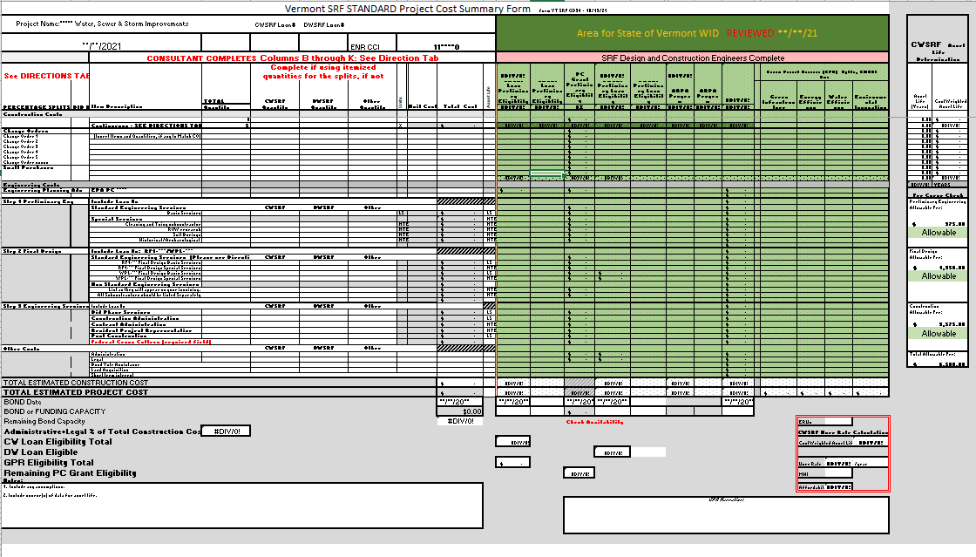
3. WID Project Cost Summary

Slide 15
Project Priority List Ranking
Project Priority List (PPL or PList) places projects into the funding list for the State Revolving Funds
Needed for Construction Loans and Grants and Land Purchase

Slide 16
When to Apply
State Fiscal Year | Priority List Application Deadline | Typical Intended Use Plan State Date | Typical Intended Use Plan End Date
SFY 22 | December 1, 2021 | Current IUP (now) & Amended IUP (TBD) | June 30, 2022
SFY 23 | Late February 2022 | July 1, 2022 | June 30, 2023
SFY 24 | Late February 2023 | July 1, 2023 | June 30, 2024
Last date to expend ARPA Funds |  |  | December 31, 2026

Slide 17
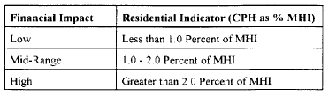
Affordability & MHI
User Rate/Median Household Income of the Service Area
Range 1%-2%

Slide 18
ARPA - Filling the Funding Gap
Loans: Local share provided through local financing of the project is still anticipated.
ARPA

Slide 19
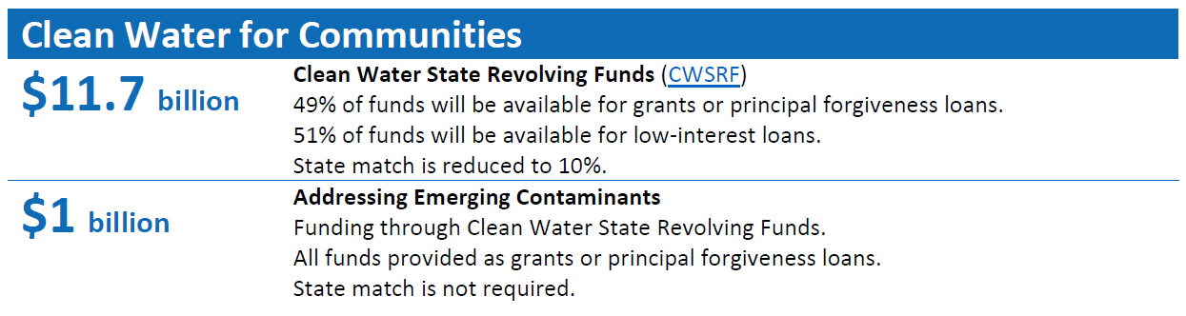
Infrastructure Investment & Jobs Act
Signed into law yesterday.

Slide 20
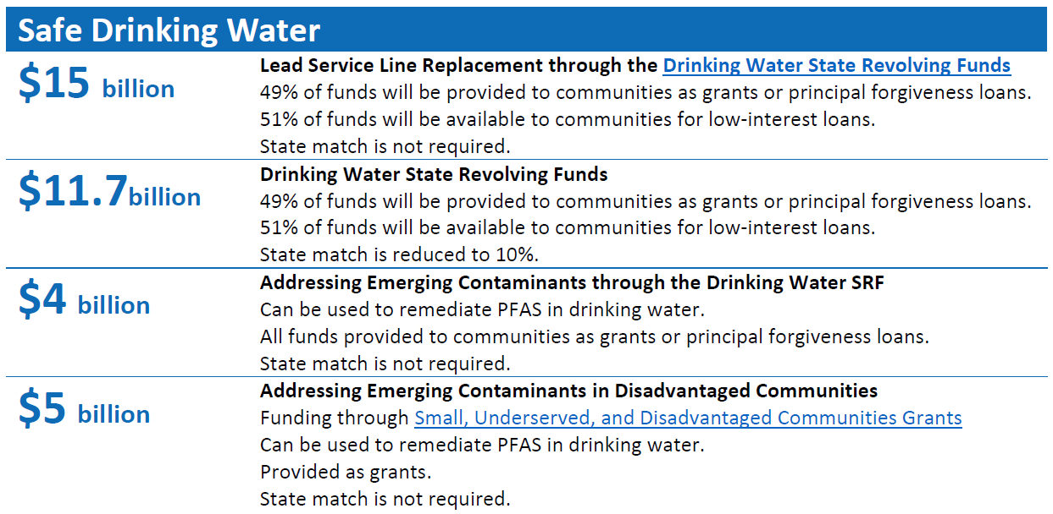

Slide 21

Questions?
It’s fun to talk about ARPA.
Lynnette Claudon
1-802-490-6226
Lynnette.Claudon@Vermont.gov
Megan Young
1-802-585-4903
Megan.Young@Vermont.gov

